Slide 1
Welcome to
our
project presentation

Slide 2
Project title:
Custom Newsflow

Slide 3
Supervised by
DR. A.H.M KAMAL Professor, Department Of Computer Science And Engineering, JKKNIU
Submitted by
MD. Maruf Hossain
Roll: 22102010
Reg: 10816
Syed Niamul Hasan Uday
Roll: 22102031
Reg: 10837

Slide 4






Table of content
Introduction and Project overview
Background Study
Working Process
Result Analysis and Discussion
Limitations
Future Scope

Slide 5
Introduction
Custom News Flow, a Java Swing application that fetches news from multiple sources using an API. The system categorizes news into different topics, offers dark mode, a favorites section, a search feature, and allows users to filter news by category and newspaper.

Slide 6
Background Study
The internet provides a vast amount of news, but finding accurate and relevant information is challenging.
2. Many websites display misleading news or excessive ads,
making it difficult to read and trust sources.
3. Our project aims to solve this by offering a centralized platform
that delivers reliable and categorized news. That’s why we aimed to make this application.

Slide 7
Working Process
Algorithm:
Step 1: Start the Application
Initialize the database for saving favorite articles.
Set up the Graphical User Interface (GUI) using Java Swing.
Step 2: Fetch News from API
Connect to News API using an HTTP request.
Retrieve the latest top headlines and display them.
Step 3: Category-Based News Filtering
Allow users to select a category (e.g., Business, Health, Sports).
Fetch and display news based on the selected category option.

Slide 8
Working Process
Algorithm:
Step 4: Search for Specific News
Take user input (search keyword).
Fetch and display relevant news articles based on the search term.
Step 5: Select News from Specific Newspapers
Show a list of trusted newspapers.
Fetch news only from the selected newspaper and display it.
Step 6: Save and View Favorite Articles
Allow users to save news articles to a favorites list.
Store saved articles in the SQLite database.
Provide an option to view saved articles anytime.

Slide 9
Working Process
Algorithm:
Step 7: Enable Dark Mode (Optional Feature)
Allow users to toggle between dark mode and light mode for better reading.
Step 8: Open Full News in Browser
When a user double-clicks an article, open the full news link in a web browser.
Step 9: Exit Application
Close the application when the user selects the exit option.

Slide 10
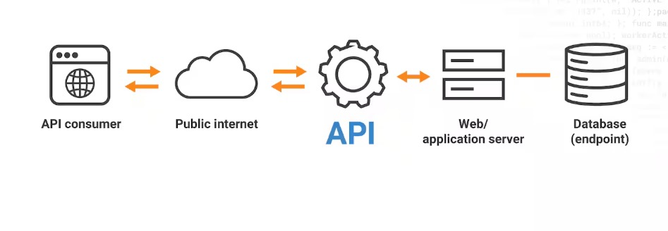
Working Process
Graphical View:

Slide 11
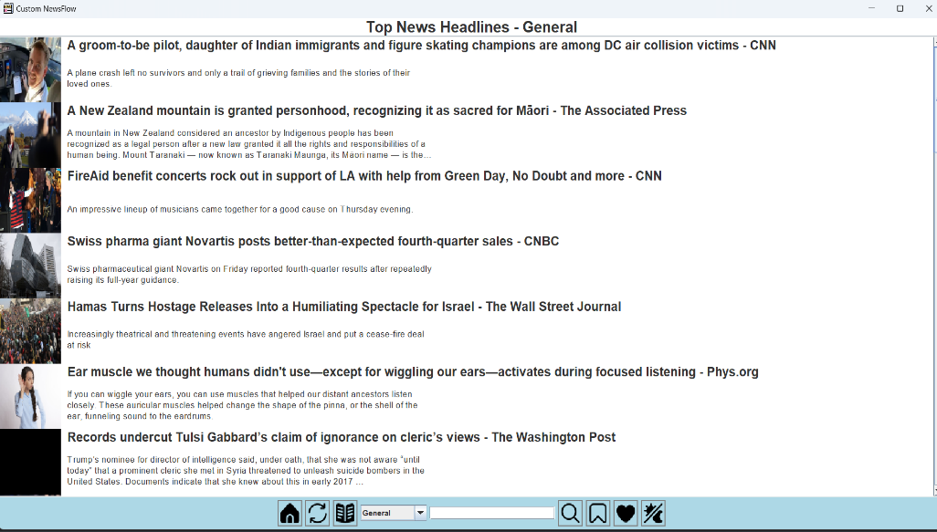
Result Analysis and discussion
Application Launch
The system starts with a user-friendly graphical interface.
The main screen displays the latest top headlines.

Slide 12
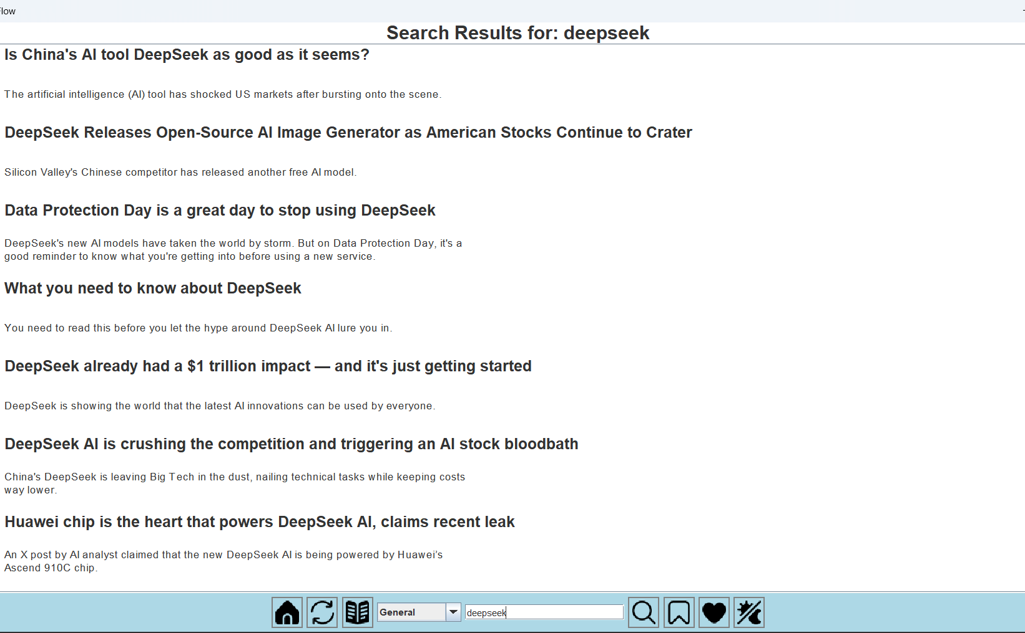
Working Process
Search & Filter Options
Users can enter keywords to search for specific news.
News can be filtered based on categories or preferred news sources.

Slide 13
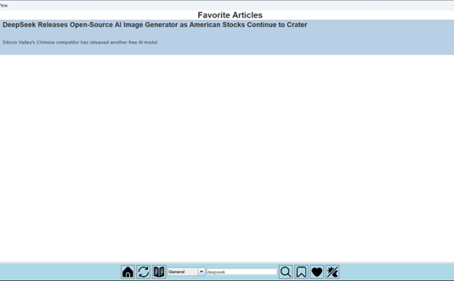
Working Process
Saving Favorite Articles
Users can save important news to their favorites.
Saved news is stored in a local database for future reference.

Slide 14
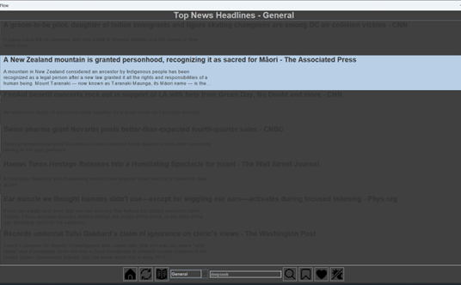
Working Process
Dark Mode & UI Customization
Users can toggle between light and dark mode.
The interface updates dynamically based on user preferences

Slide 15

Working Process
Closing the Application
Users can exit the program safely, with data stored for future use.

Slide 16
Limitations
Limited News Sources: The project only supports a predefined set of news sources (10 newspapers) from the NewsAPI, limiting the variety of available news.
Dependence on External API: The project relies on NewsAPI, meaning functionality is limited by API availability, response times, and rate limits.
API Data Limitations: The fetched articles may not cover all news events or regions, as NewsAPI's coverage can be restricted.
Performance with Large Data: While the app supports paginated news fetching, performance may degrade with a large number of articles or slow internet connections.
UI Customization: The user interface is relatively basic and lacks advanced customization or personalization options.
No User Authentication: The app does not support user accounts or authentication, limiting personalized features.

Slide 17
Future Scope
Integration of More News Sources: Future versions can expand the number of news sources, allowing users to select from a wider range of newspapers or news outlets.
User Authentication: Adding user login and account management would allow users to save their preferences, favorite articles, and settings across devices.
Offline Mode: Implementing offline functionality would allow users to access previously fetched articles without an internet connection.
Push Notifications: The app can be enhanced to send notifications for breaking news or personalized updates based on user preferences.
Enhanced Search Capabilities: Integrating advanced search features such as filters for date range, source, or keyword relevance could improve the user experience.
Mobile Version: Developing a mobile application for iOS and Android platforms would increase accessibility and reach.

Slide 18

Thank you
For your patience

Slide 19

Any questions?

